Slide 1

Goal 1 – Wave Properties
Determine the properties of waves.

Slide 2
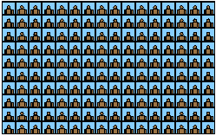

Slide 3
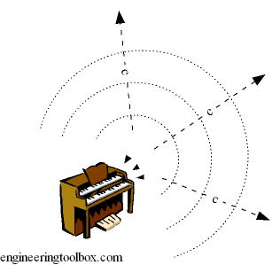
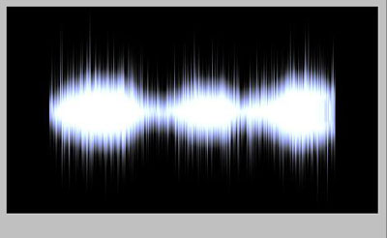
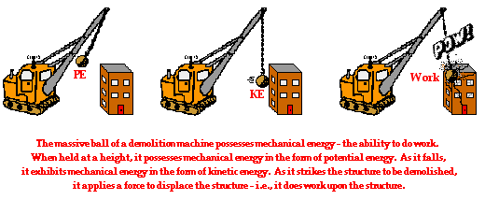
Vocabulary to Begin
Medium - Material through which a wave travels
Mechanical Wave - Waves that require a medium through which to travel.
Wave - disturbance that transfers energy from place to place
Energy - ability to do work

Slide 4
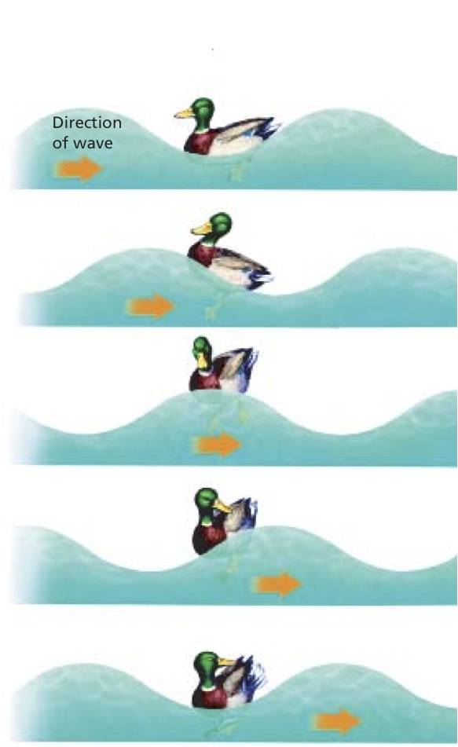
Why doesn't the medium travel along with the wave?
All mediums are made of tiny particles. When a wave enters a medium, it transfers energy to the medium's particles. The particles bump into each other, passing the wave's energy along.
Think of how food is passed at the table...
Notes:
Feel free to delete. I reference the duck moving up and down and not moving with the wave.

Slide 5
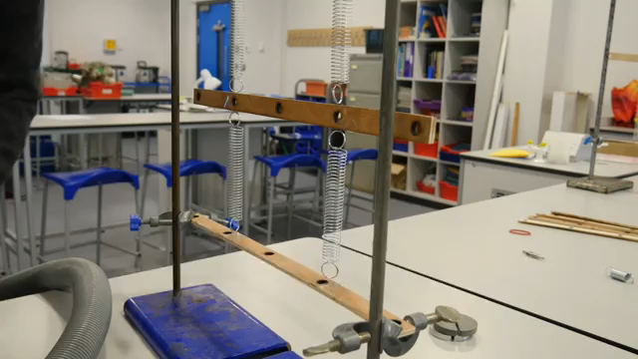
What is a vibration?
A vibration is the repeated back and forth/up and down motion. Started by energy being put into a system.
Notes:
There are many videos on this topic, but this is my favorite.

Slide 6
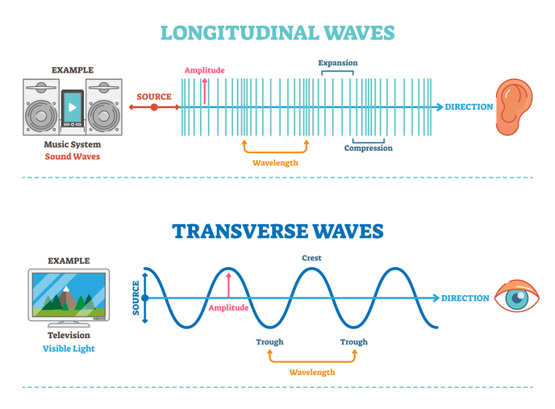
What are mechanical waves?
Mechanical Waves are waves which spread through a material medium (solid, liquid, or gas) at a wave speed which depends on the elastic and inertial properties of that medium.
Notes:
There are two basic types of wave motion for mechanical waves: longitudinal waves and transverse waves.

Slide 7
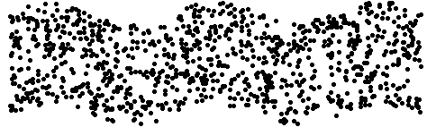
What is a transverse wave?
A transverse wave is a mechanical wave that travel perpendicular to an applied force

Slide 8
Parts of a transverse wave
Crest – Highest part of a wave
Trough – Lowest part of a wave
Amplitude – Distance from resting position to crest/trough
Wavelength – Crest to crest. Trough to trough. (Any point on one wave to the identical point on the next wave).
Notes:
Kids do need help with wavelength

Slide 9
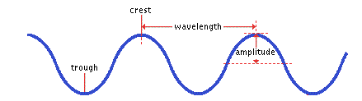
Draw a transverse wave, label the parts.

Slide 10
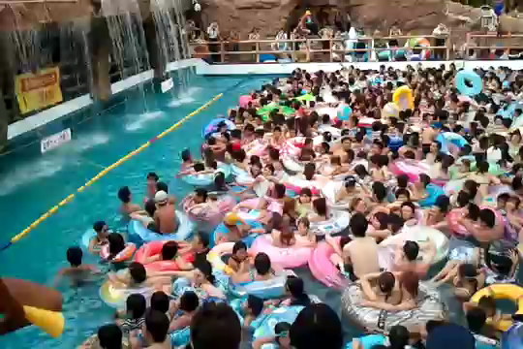
Tokyo, Japanese Wave Pool

Slide 11
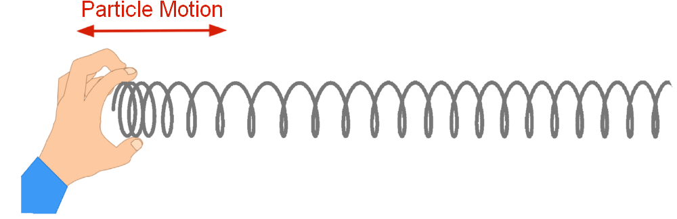
What is a longitudinal wave?
A longitudinal wave is a mechanical waves in which the vibration of the particles takes place in the same direction as that of the wave

Slide 12
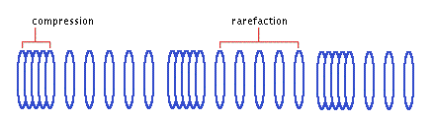
What is a longitudinal wave?
Wave that moves the medium PARALLEL to the direction in which the waves travel.

Slide 13
Parts of a longitudinaal wave
Compression – Close parts of a longitudinal wave.
Rarefaction – Far apart parts of a longitudinal wave.

Slide 14
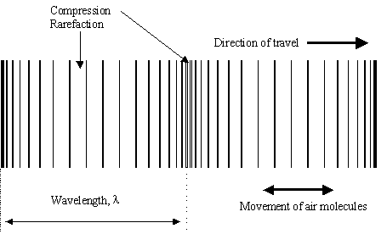
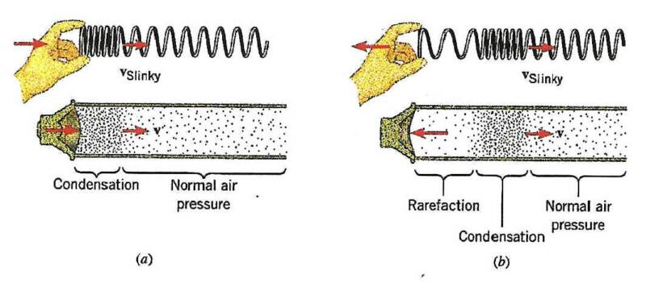
Draw a longitudinal wave

Slide 15
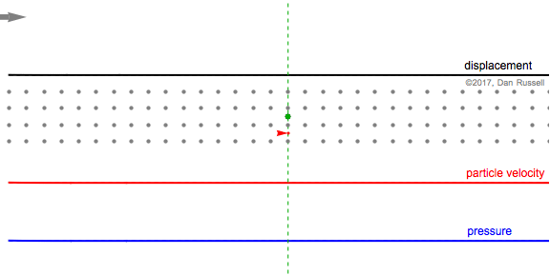
Longitudinal Wave

Slide 16
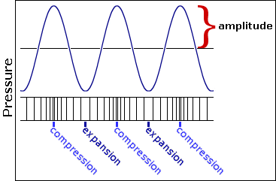
What is the amplitude of a longitudinal wave?

Slide 17
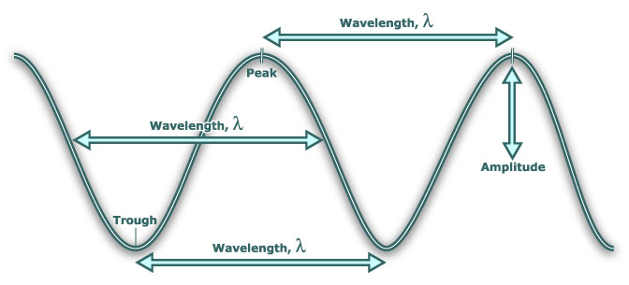
What is wavelength?
Distance between two corresponding parts of a wave. Yes, I want you to draw 2 more wavelengths on your wave.

Slide 18
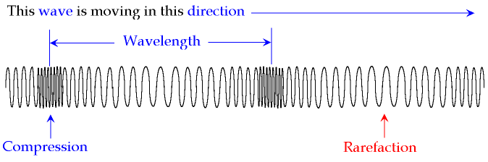
What is the wavelength of a longitudinal wave? Yes I want you to draw this.

Slide 19
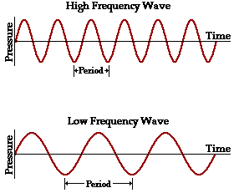
What is frequency?
Number of complete waves that pass a given point in a certain amount of time. Yes, draw and label this.

Slide 20
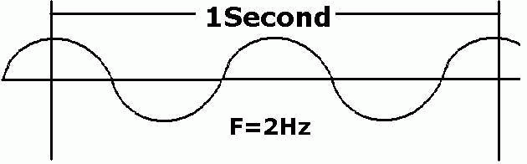
What is frequency measured in?
Hertz: The number of hertz (Hz) equals the number of cycles per second.

Slide 21
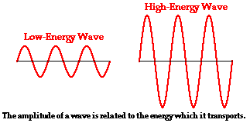
Which wave property is directly related to energy?
Amplitude

Slide 22
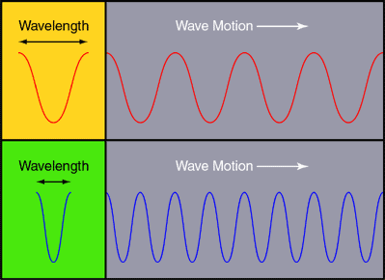
How are wavelength and frequency related?
As wavelength increases, the frequency decreases and as frequency increases the wavelength decreases. This is an Inverse Relationship.
Frequency
Wavelength

Slide 23
Learning Target Assessment
Determine the properties of waves.

